Slide 1


Cleckhuddersfax Online Mart
Project Management ( Team Default )

Slide 2
Team Default

Slide 3

Team Members

Slide 4

Kritika Koirala Specialist
Discussion : Requirements
Use-case Model
Time : 4 min

Slide 5

Anish Ghimire Monitor Evaluator
Discussion: ERD
EERD
Composite EERD
Time : 4 min

Slide 6

Ayush Pant Implementer
Discussion : MS-Project
Wireframe
Website in Progress (Homepage)
Time : 4 min

Slide 7

Mohammad Farhan Shaper
Discussion: Belbin Analysis
Skill Audit
Communication
Collaboration Tools
Team Meetings
Time : 4 min

Slide 8

Phurbu Choden Lama Resource Investigator
Discussion : Introduction
Project Initiation
Time : 4 min

Slide 9
Overview
Cleckhuddersfax Online Mart is an internet business site which will be made so as to settle the present market emergency for the nearby retailers at Cleckhuddersfax. With the online market blossoming all around the world, Cleckhuddersfax is no more interesting to its impact on the neighborhood advertise and physical outlets. Chfonlinemart.com will be the response to handle the present issue and furnish the nearby retailers with an online stage for the retailing of their merchandise.

Slide 10
Project Planning
Project
Initiation
Project
Execution

Slide 11
Project Charter
General Objectives
Specific Objectives
Project Organization

Slide 12
Project Organization
Staffing
Kritika Koirala
Anish Ghimire
Ayush Pant
Mohammad Farhan
Phurbu Choden Lama
Communications
Status reports will be provided to the Project Manager on weekly basis as well as upon request by the Documentation manager.
Planning/Tracking
Slack
Trello
Github
Document/System Access:
The project manager has authorized access to any project document or system in the pursuit of this project completion.

Slide 13

Specialist, Coordinator,
Complete Finisher
Kritika Koirala
Cleckhuddersfax
Online Mart
Monitor Evaluator, Specialist,
Complete Finisher
Anish Ghimire
Implementer, Plant,
Team Worker
Ayush Pant

Slide 14
Shaper, Team Worker,
Coordinator
Mohammad Farhan
Cleckhuddersfax
Online Mart
Resource Investigator, Shaper,
Team Worker
Phurbu Choden Lama

Slide 15

Skill Audit

Slide 16
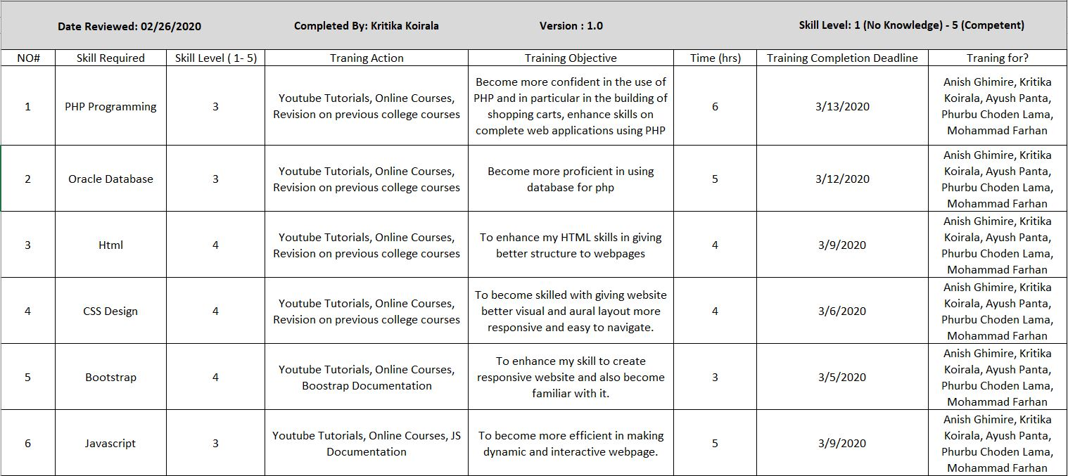

Slide 17
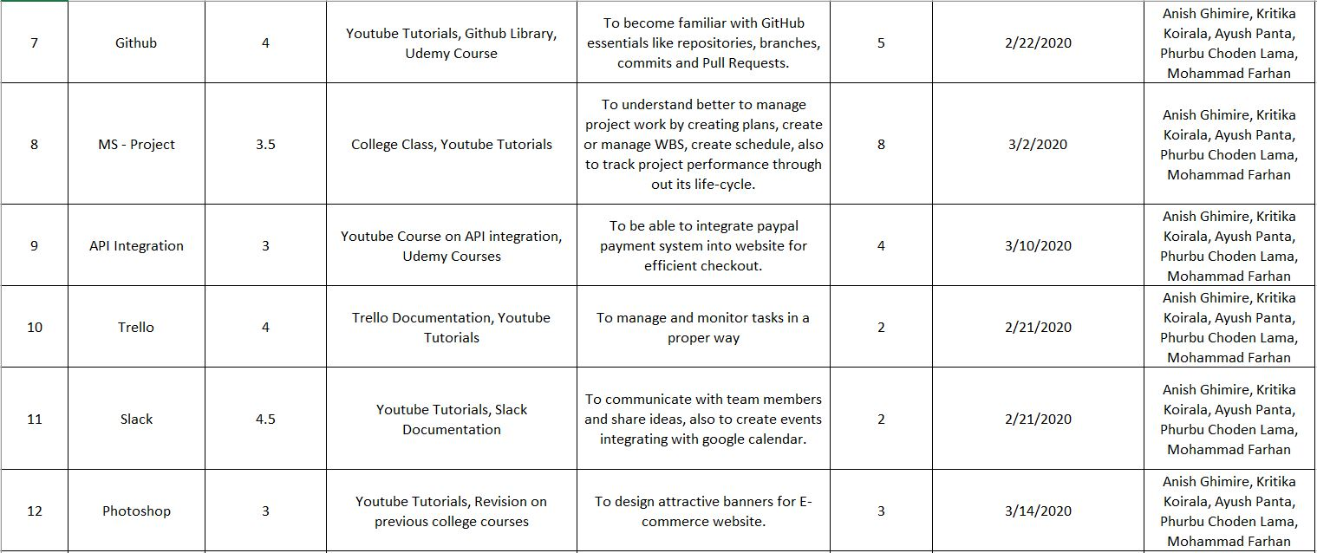

Slide 18
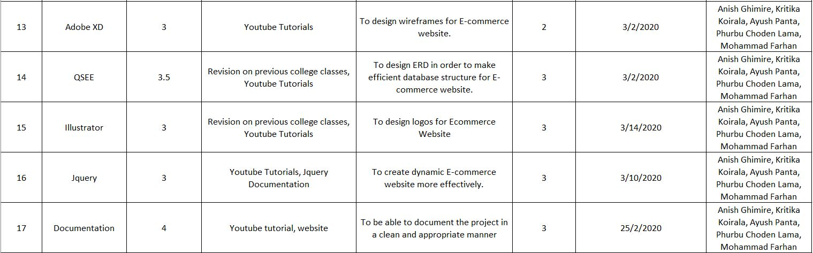

Slide 19
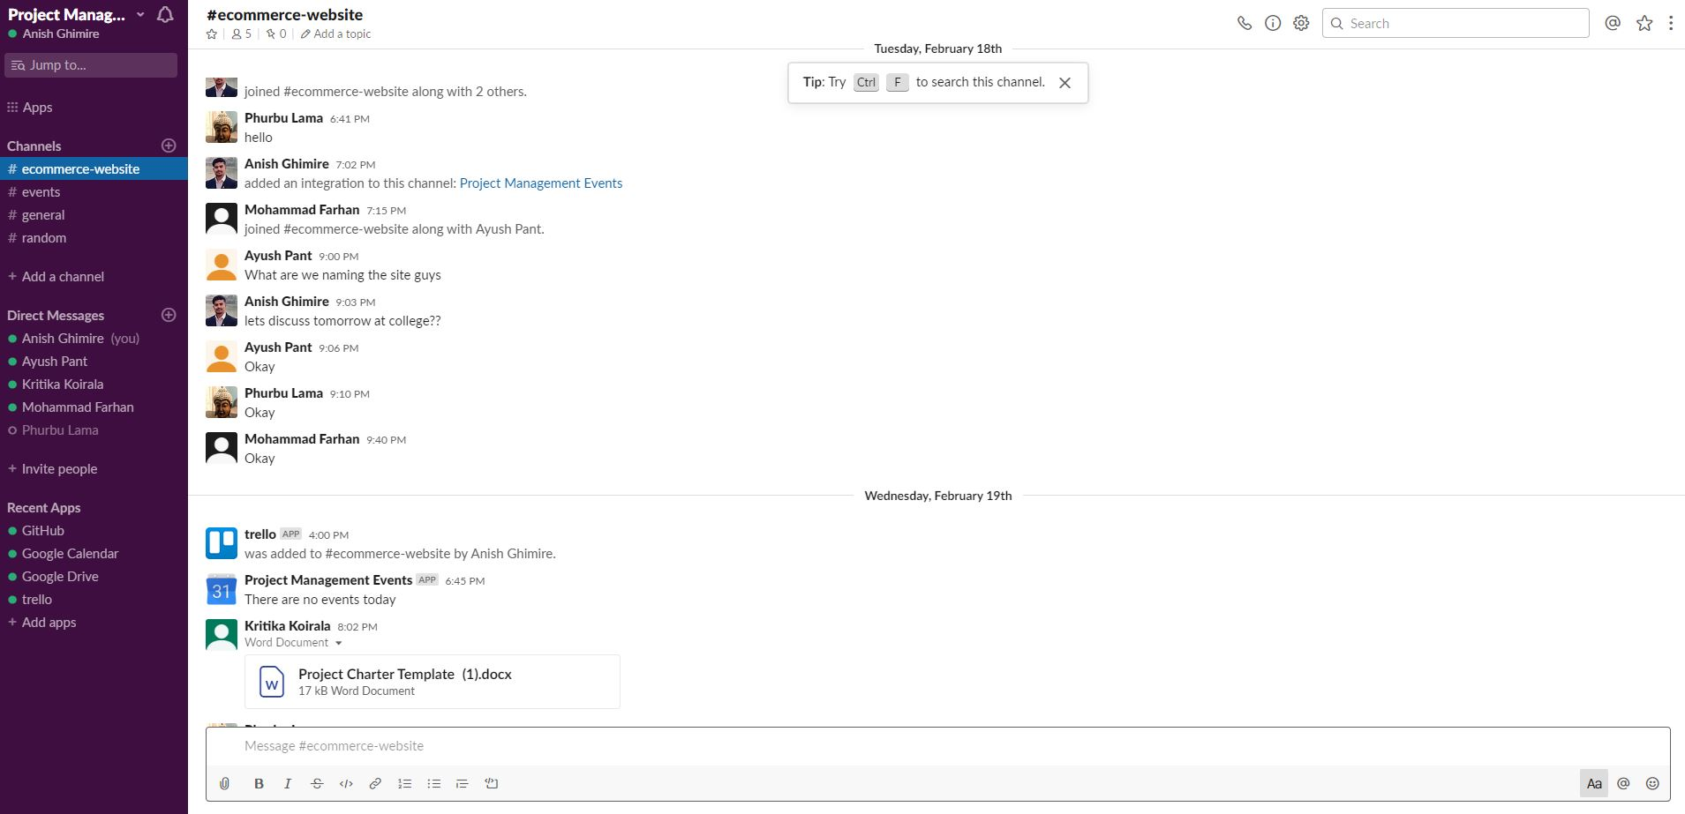
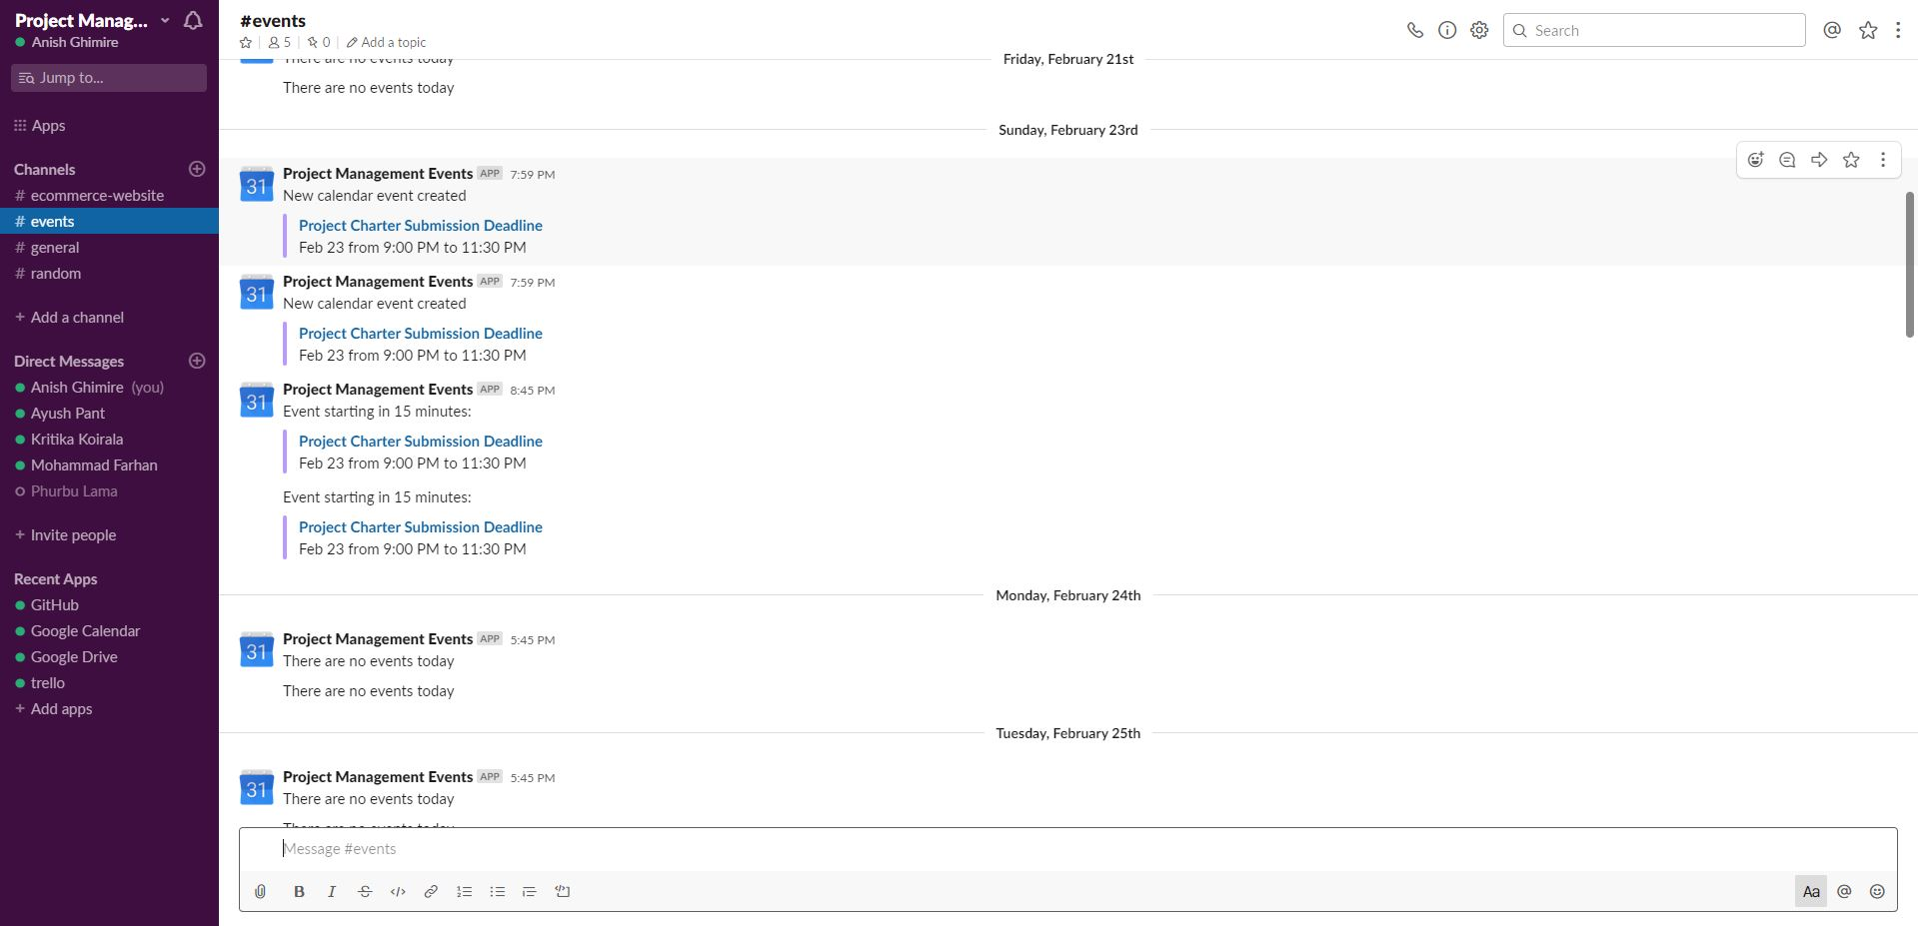
Communication and Collaboration Tools
Slack

Slide 20
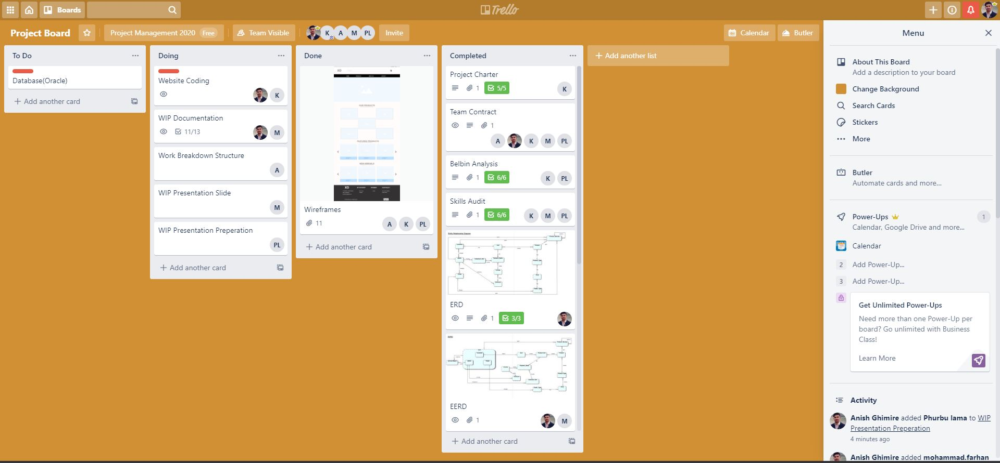
Trello

Slide 21
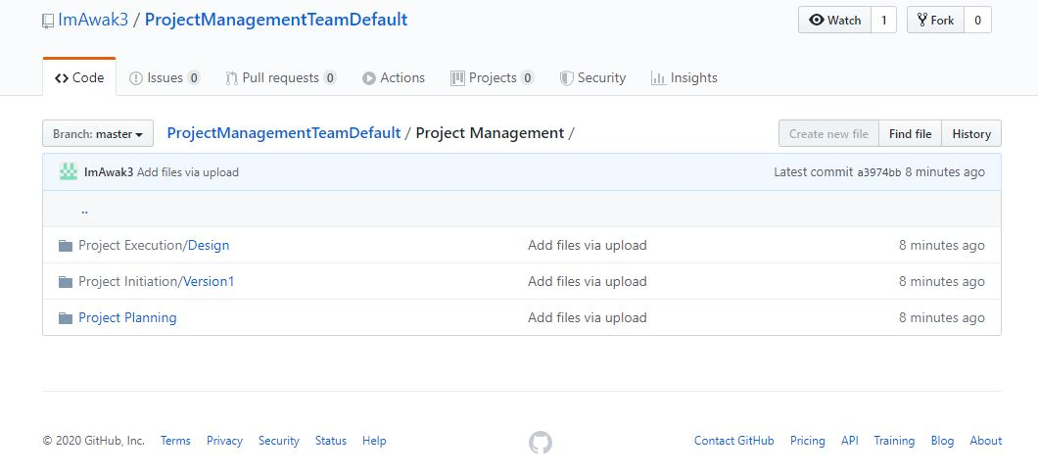
Github

Slide 22
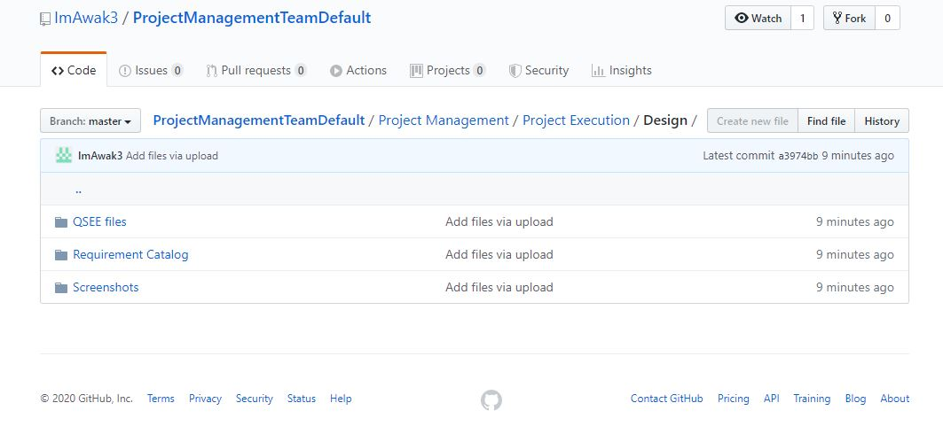
Github

Slide 23
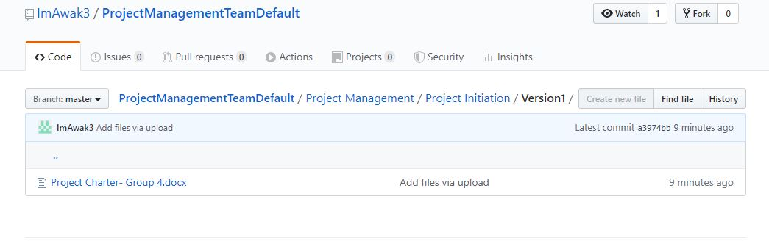
Github

Slide 24
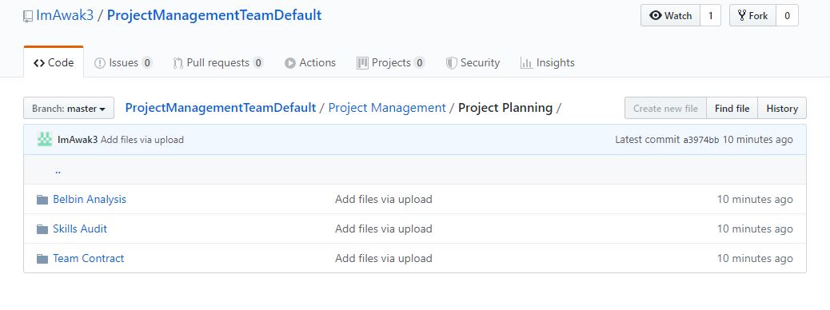
Github

Slide 25

MS Project
Microsoft Project is a project management software product, developed and sold by Microsoft. It is designed to assist a project manager in developing a schedule, assigning resources to tasks, tracking progress, managing the budget, and analyzing workloads.

Slide 26
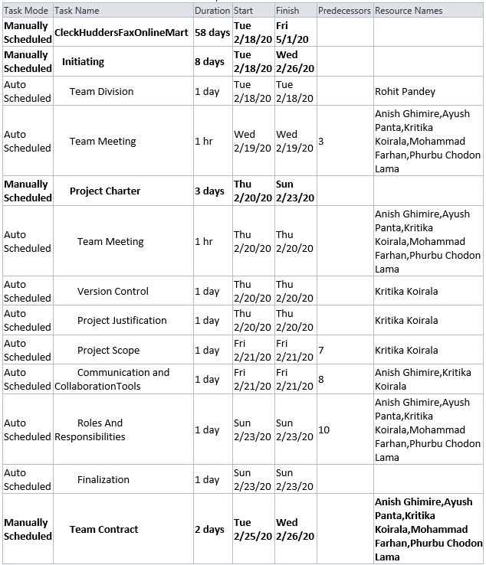
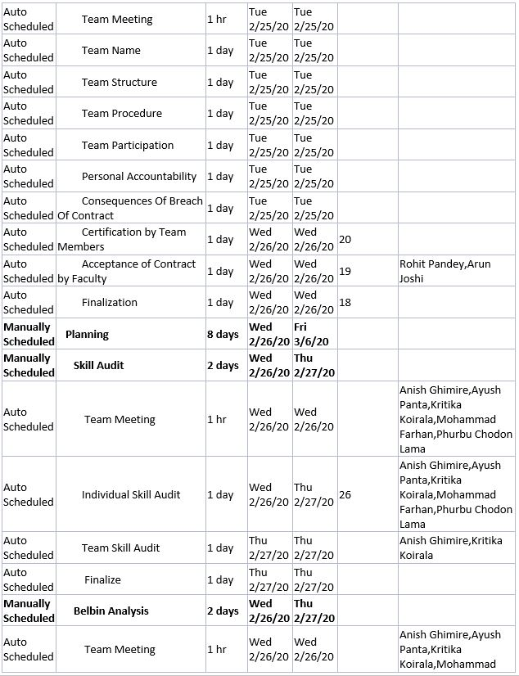
Task Sheet

Slide 27
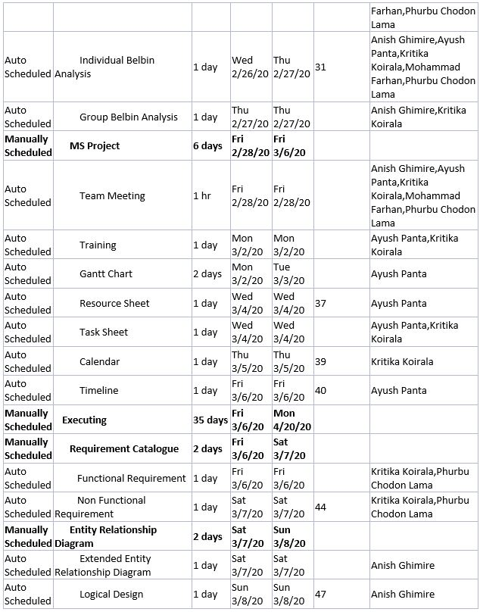
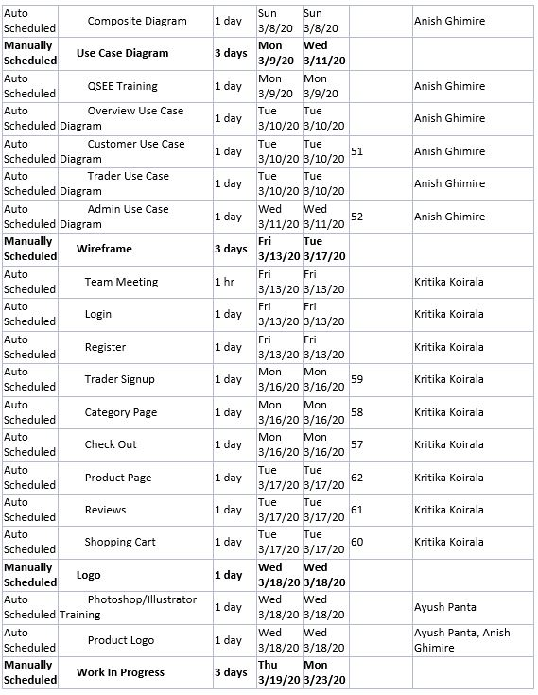
Task Sheet

Slide 28
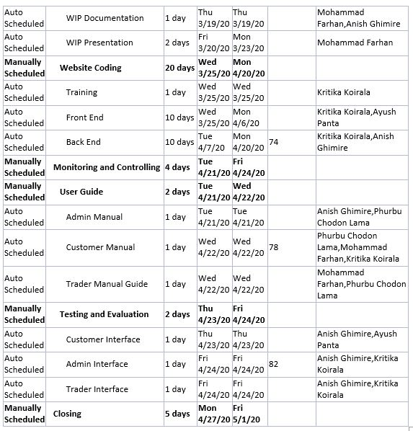
Task Sheet

Slide 29
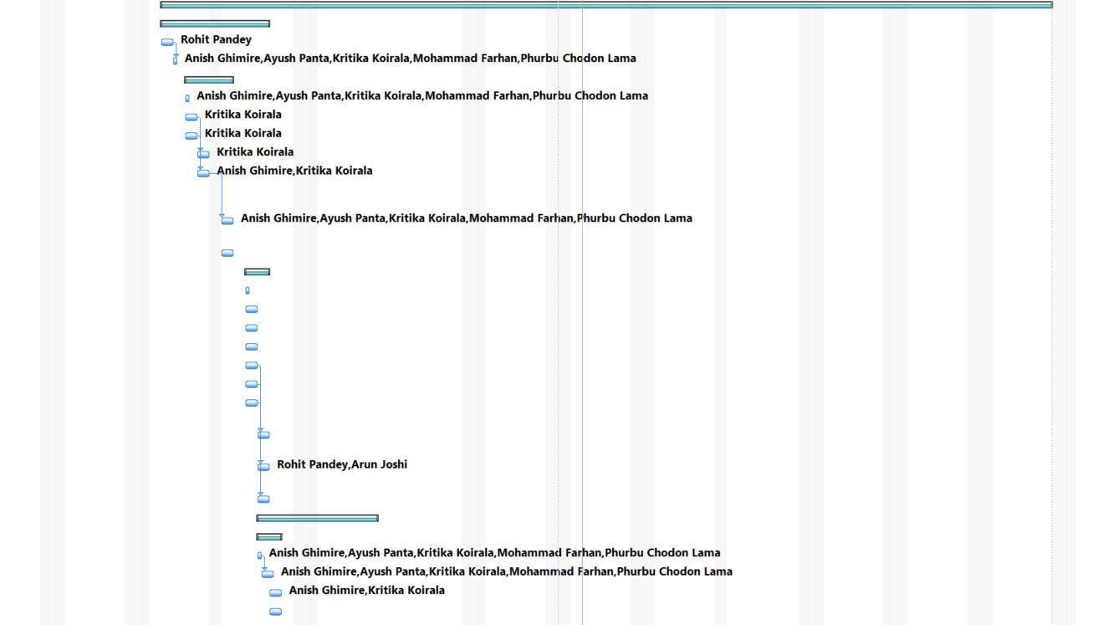
Gantt Chart

Slide 30
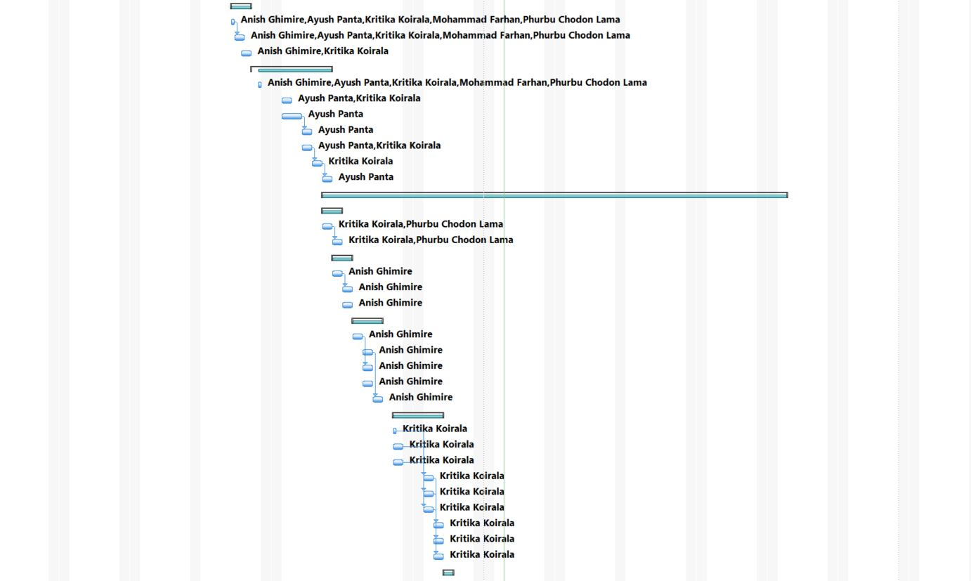
Gantt Chart

Slide 31
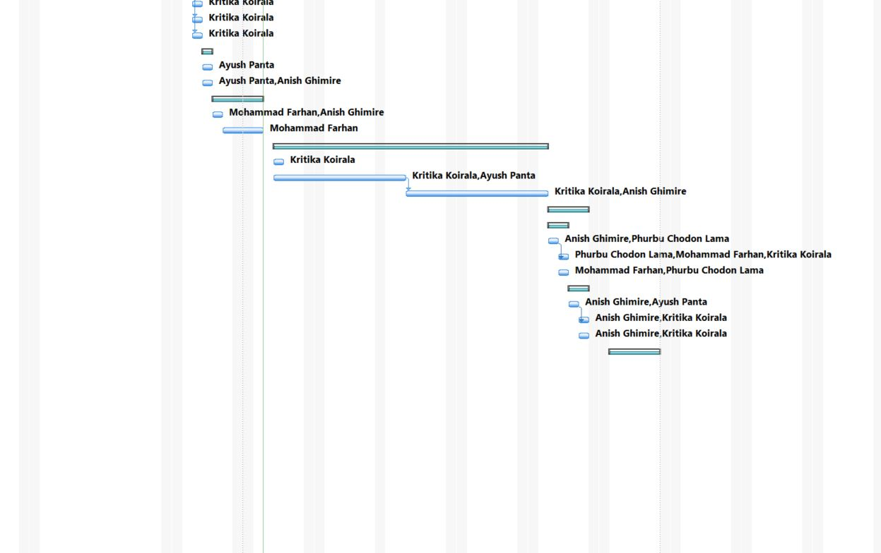
Gantt Chart

Slide 32
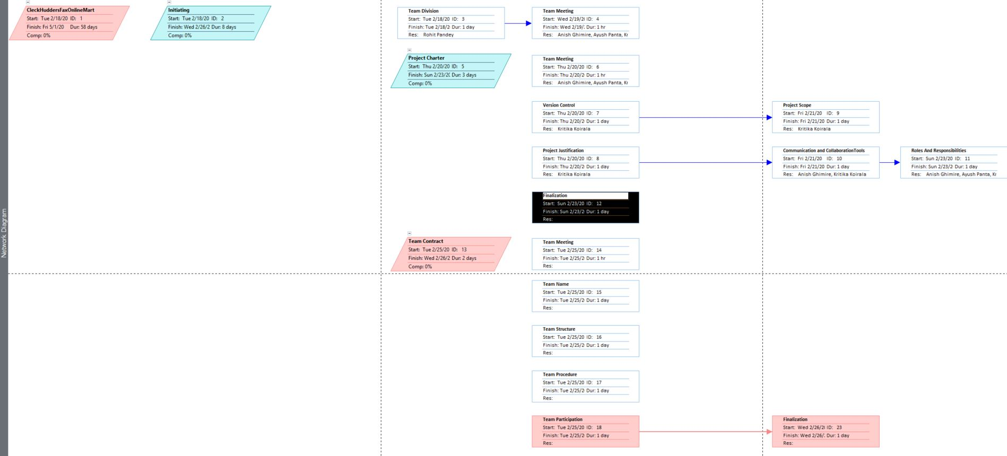
Network Diagram

Slide 33
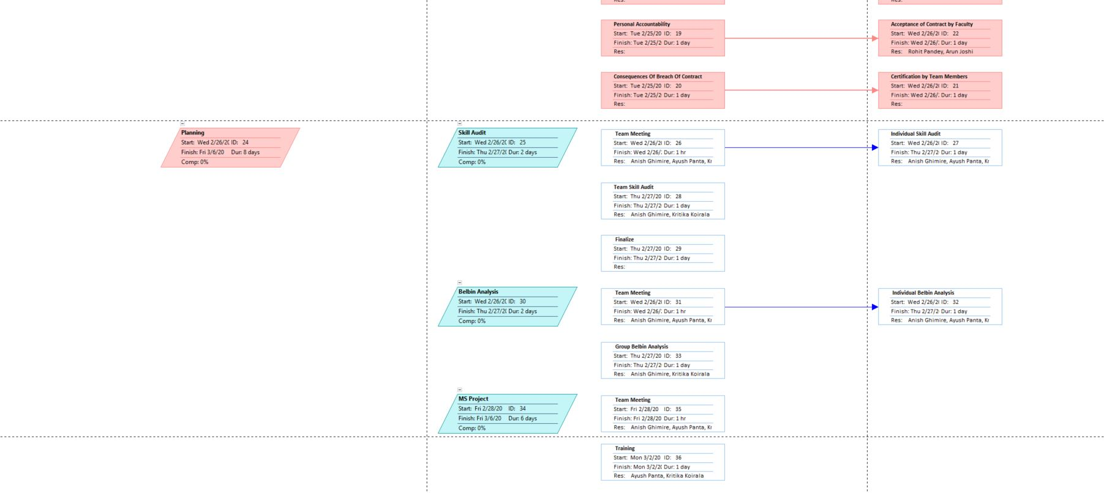
Network Diagram

Slide 34
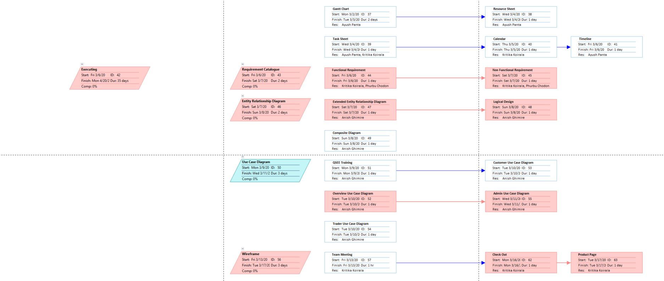
Network Diagram

Slide 35
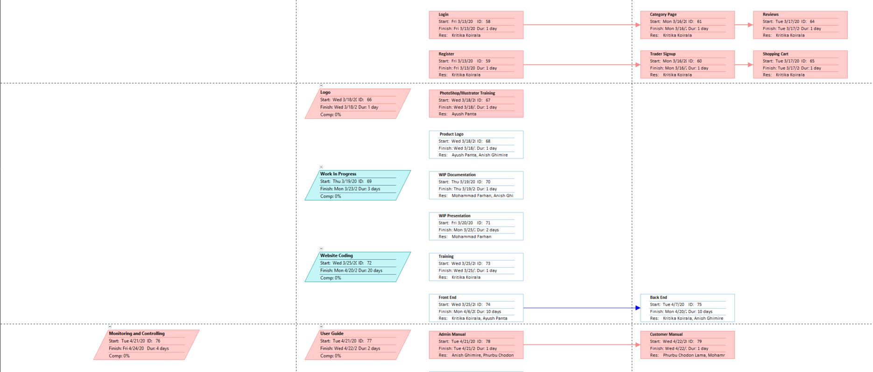
Network Diagram

Slide 36
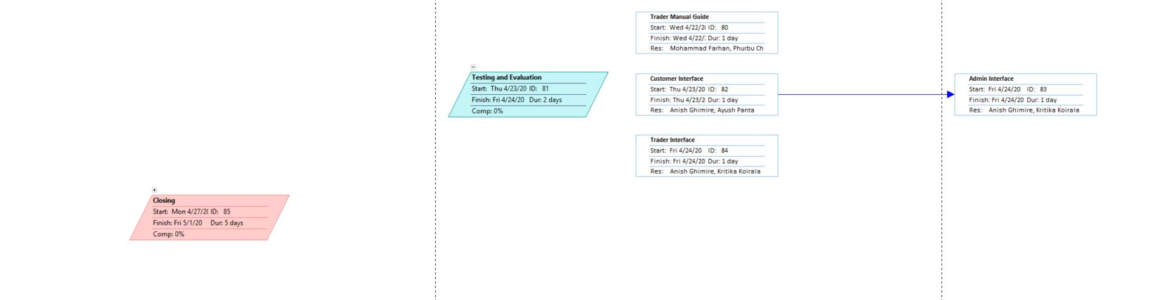
Network Diagram

Slide 37
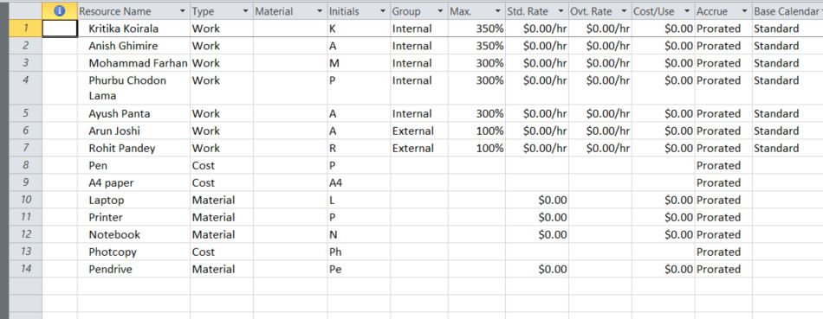
Resource Sheet

Slide 38
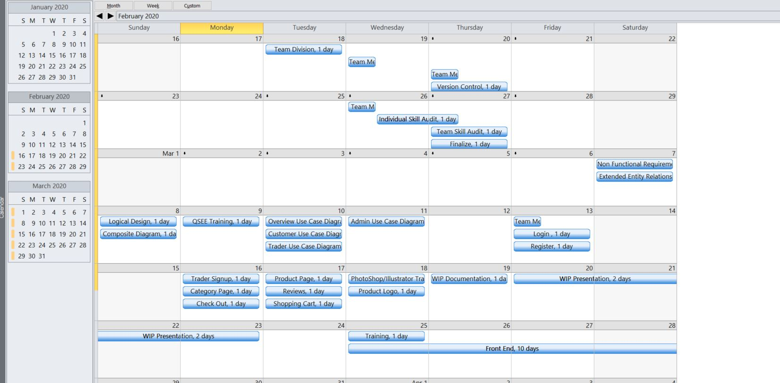
Calendar – February/March 2020

Slide 39
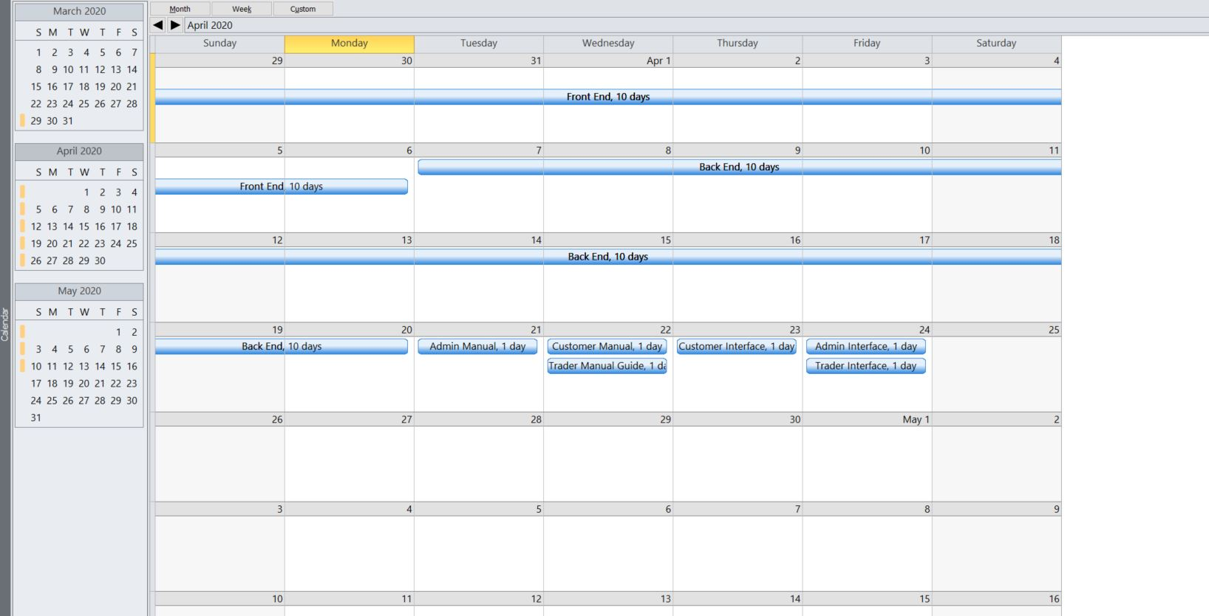
Calendar – March/April 2020

Slide 40
Timeline

Slide 41

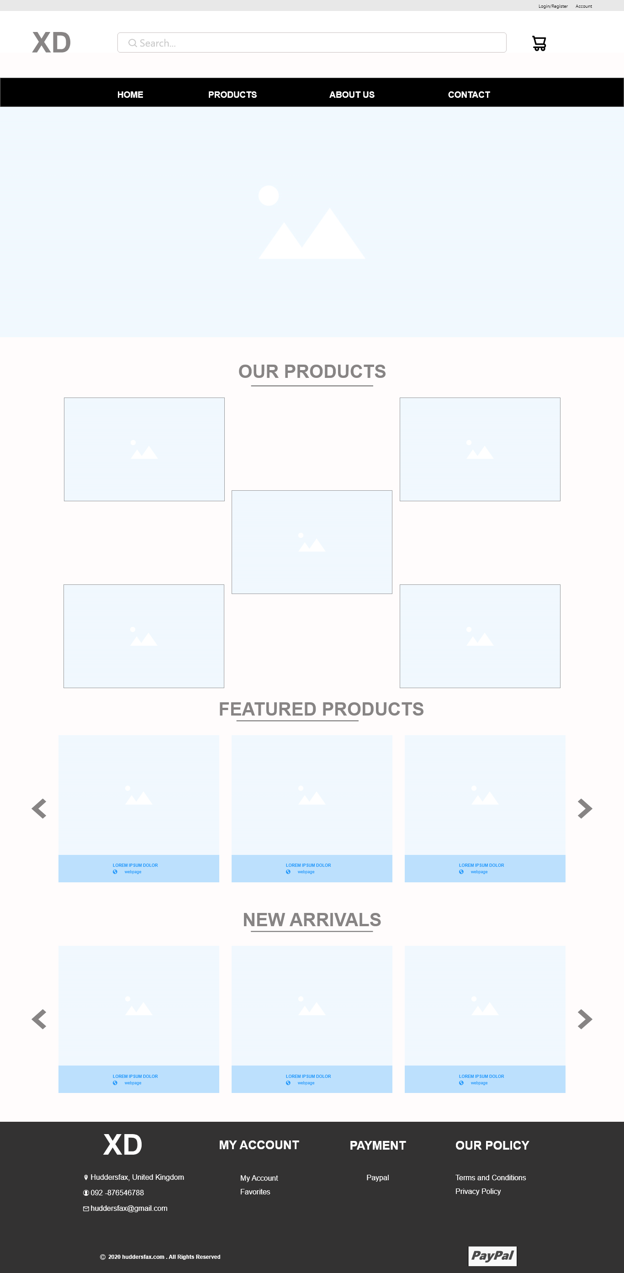
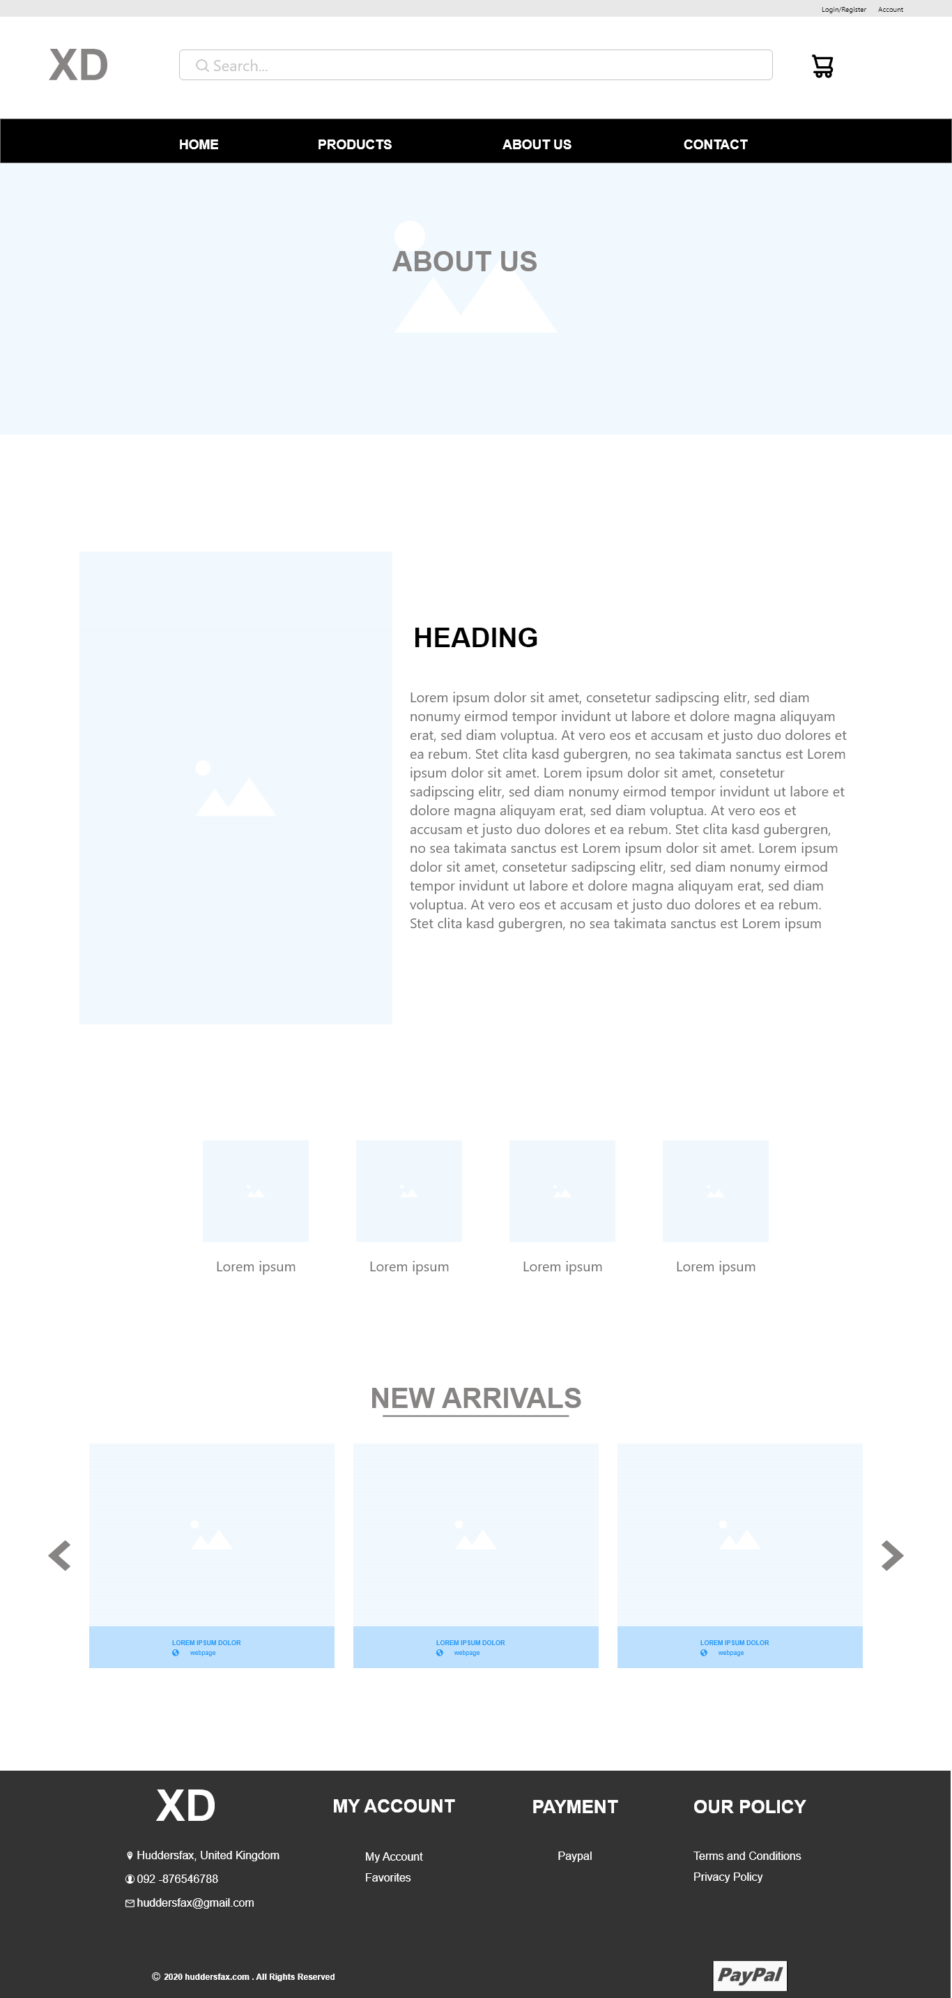
Wireframe

Slide 42
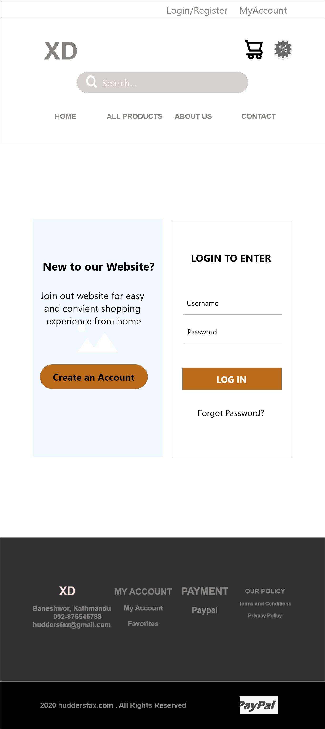
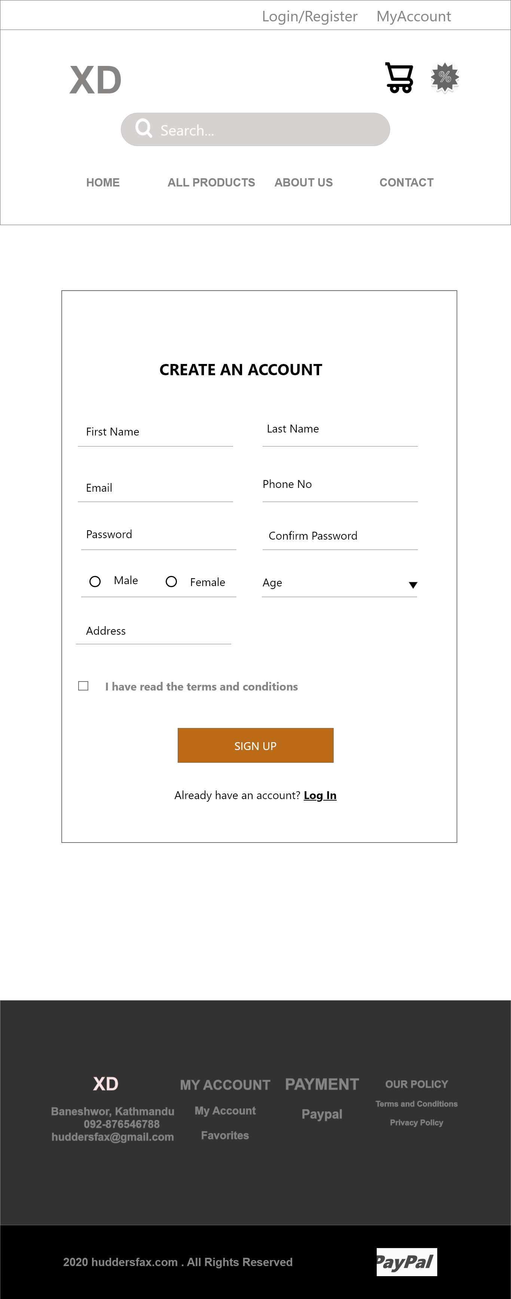
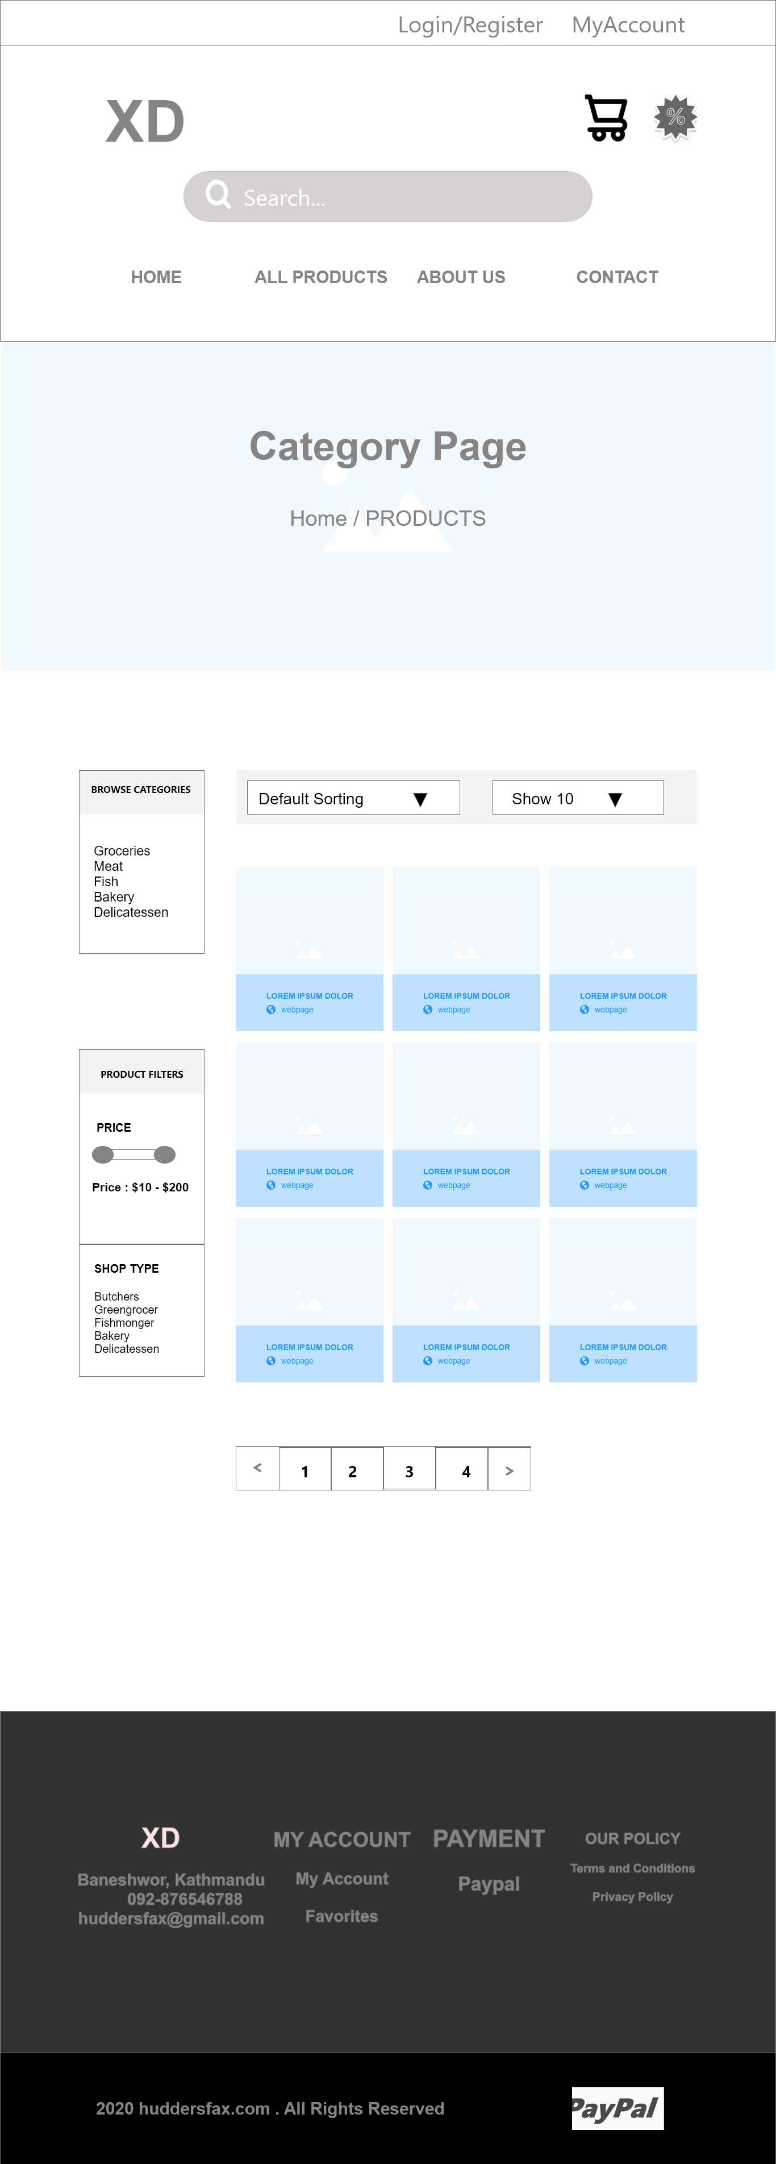
Wireframe (Customer)

Slide 43
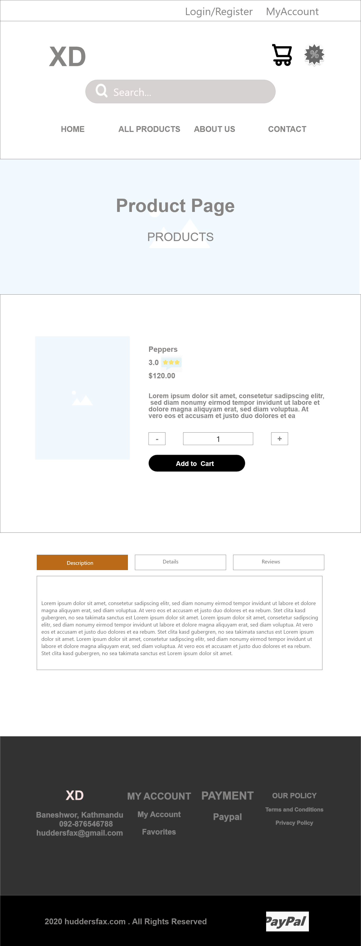
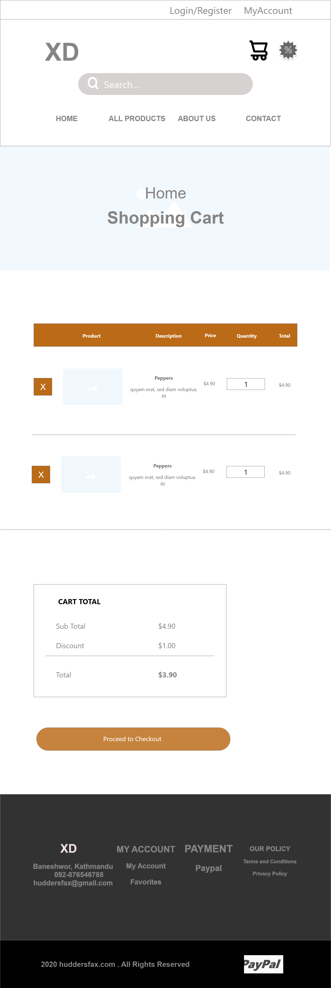
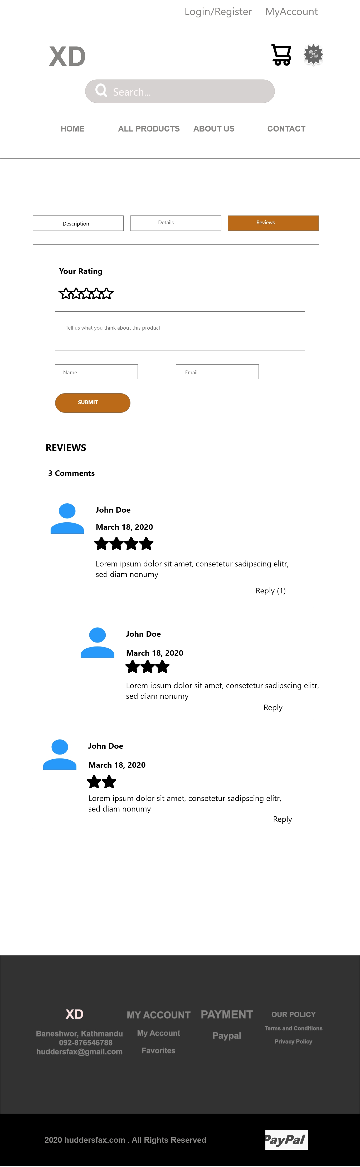

Slide 44
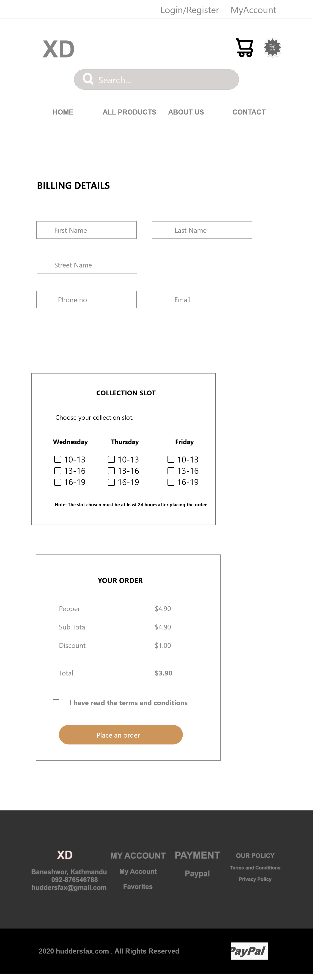

Slide 45
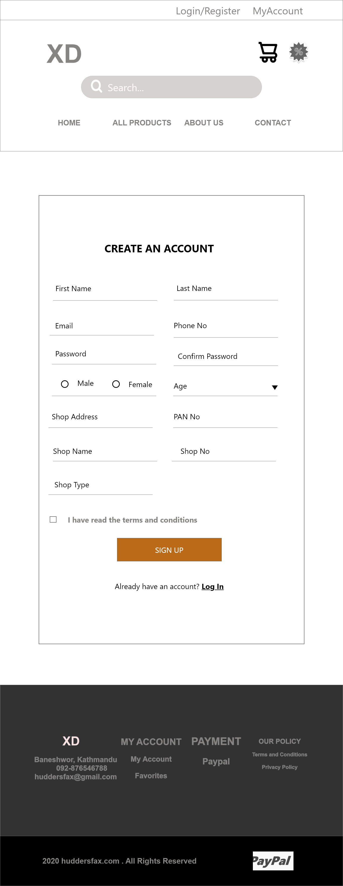
Wireframe (Trader)

Slide 46
Wireframe (Admin)

Slide 47

Website In Progress

Slide 48
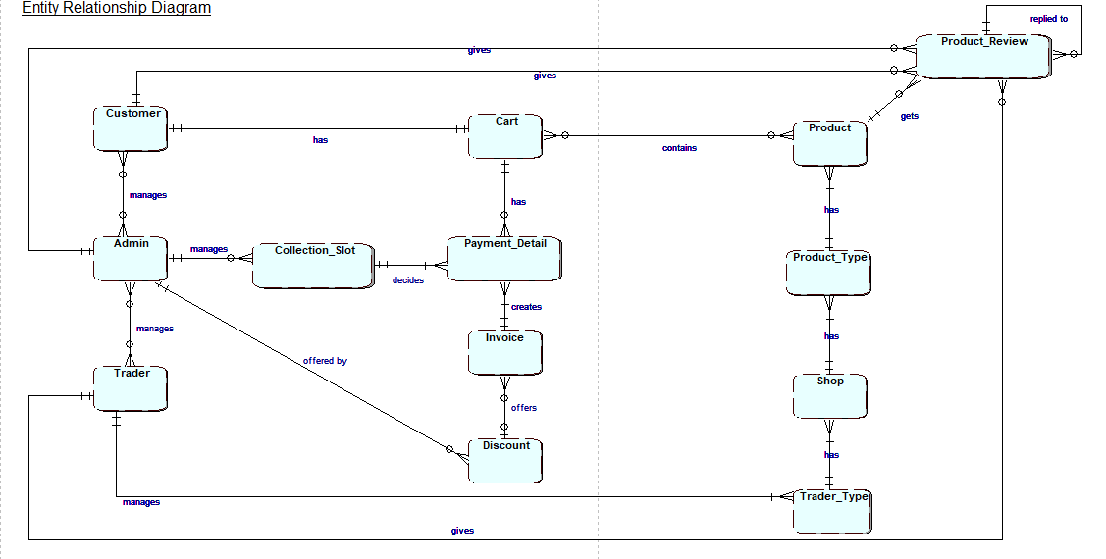
Entity Relationship Diagram

Slide 49
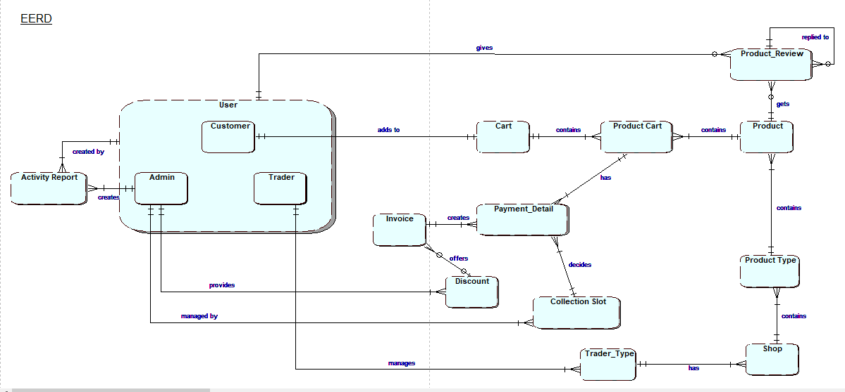
Extended Entity Relationship Diagram

Slide 50
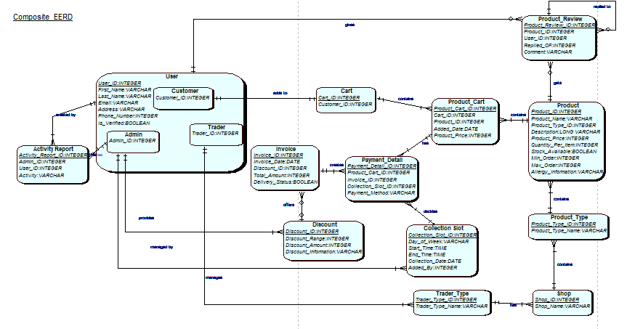
Composite EERD

Slide 51
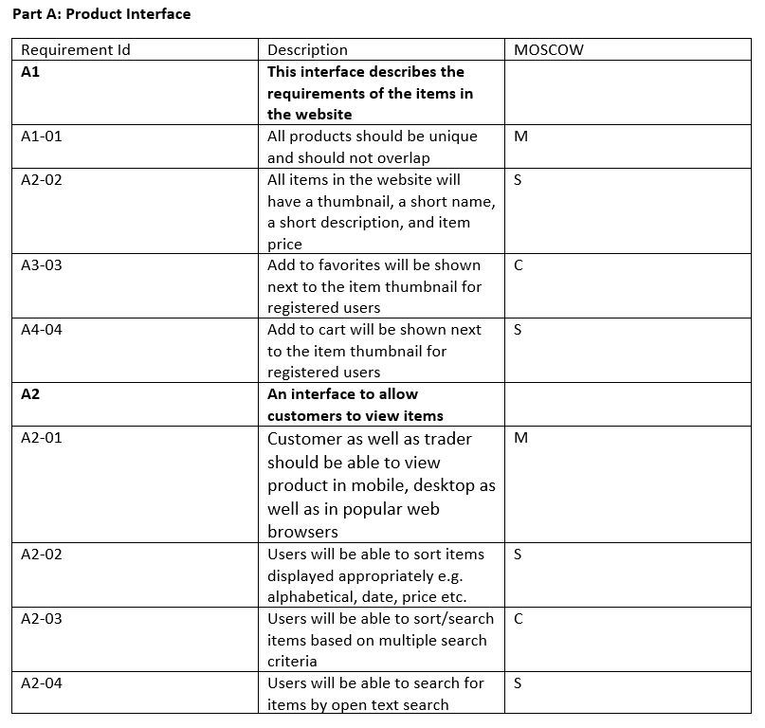
Functional Requirements

Slide 52
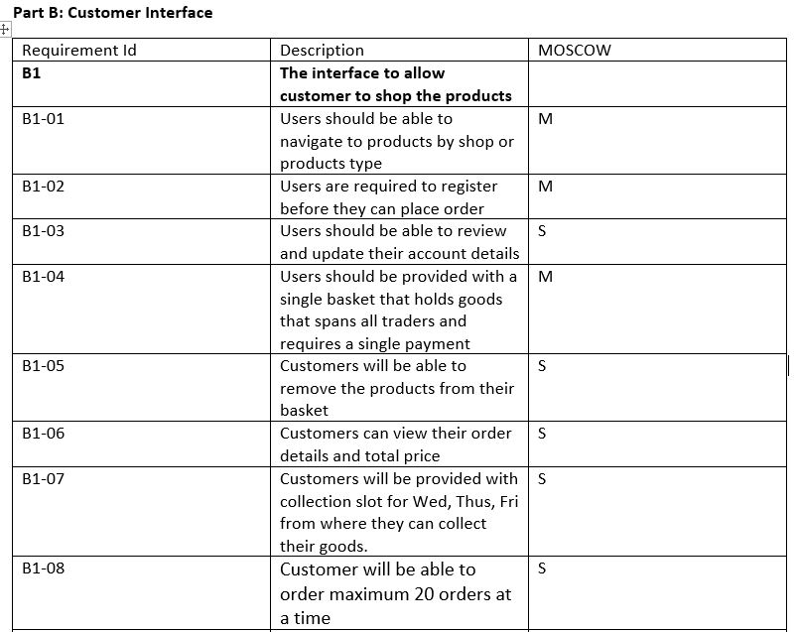
Functional Requirements

Slide 53
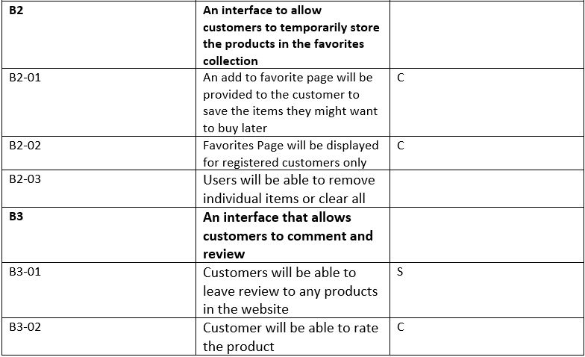
Functional Requirements

Slide 54
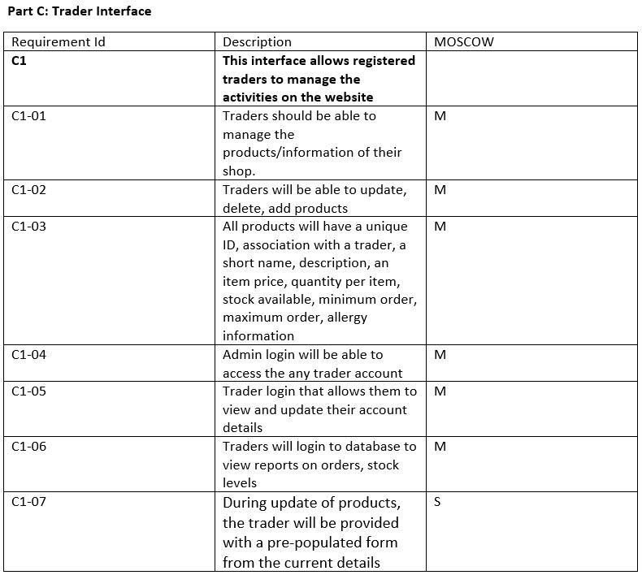
Functional Requirements

Slide 55
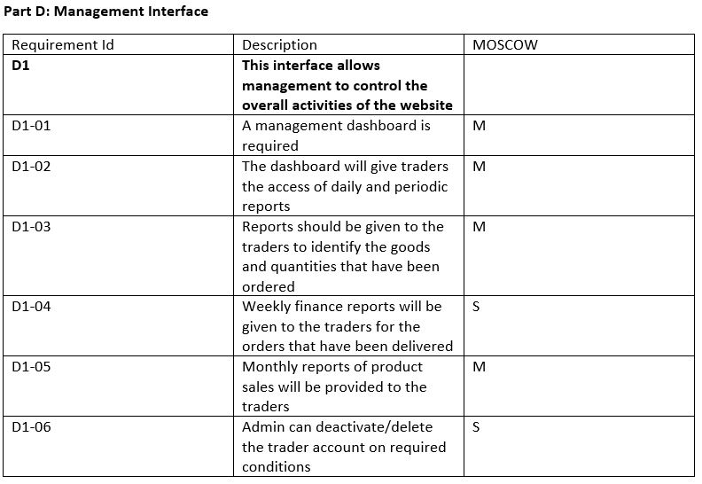
Functional Requirements

Slide 56
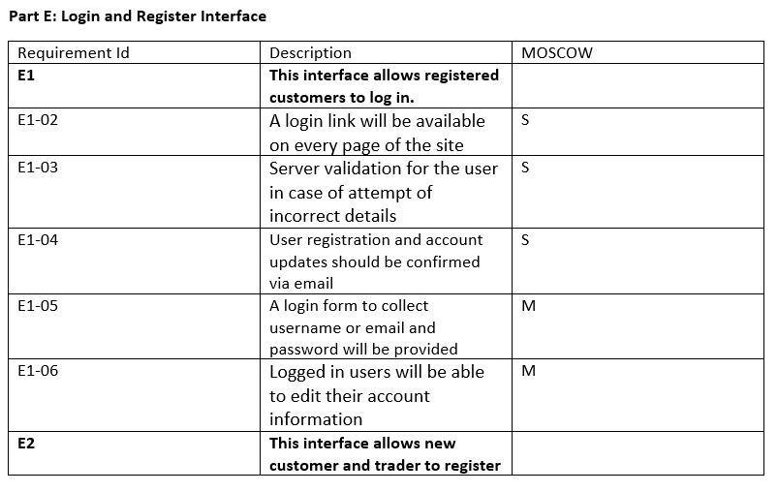
Functional Requirements

Slide 57
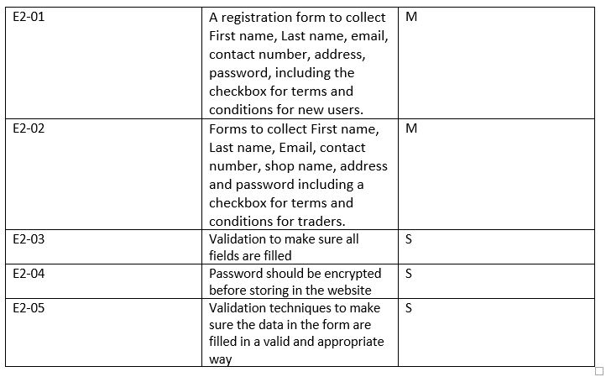
Functional Requirements

Slide 58
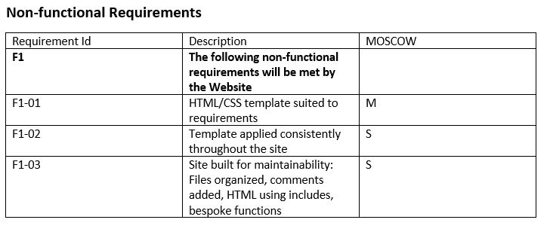

Slide 59
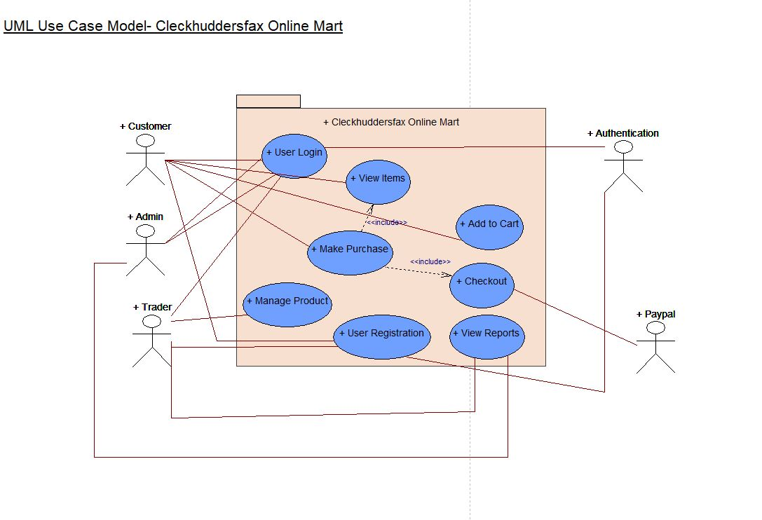
Conceptual Design

Slide 60
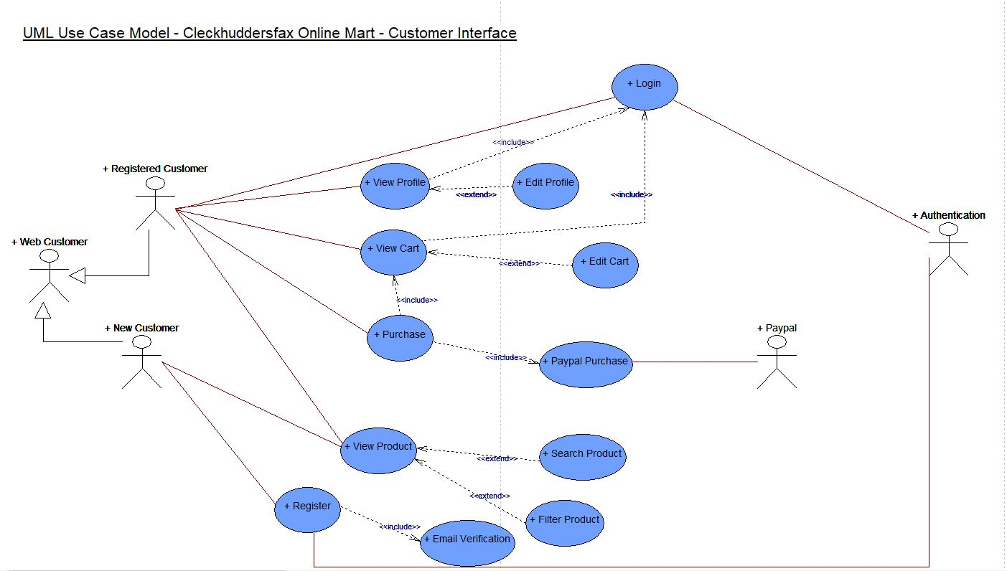
Use Case Diagram
Customer Use case Diagram

Slide 61
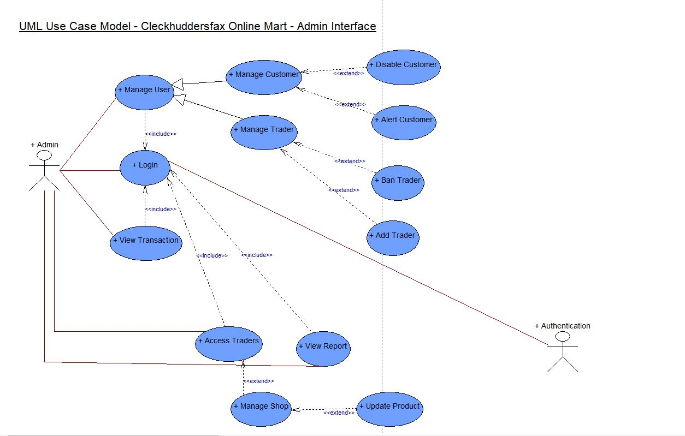
Use Case Diagram
Admin Use case Diagram

Slide 62

Use Case Diagram
Trader Use case Diagram

Slide 63
Thank you.

